Slide 1
Spotify Playlist Generator
BeatBuilders

Slide 2
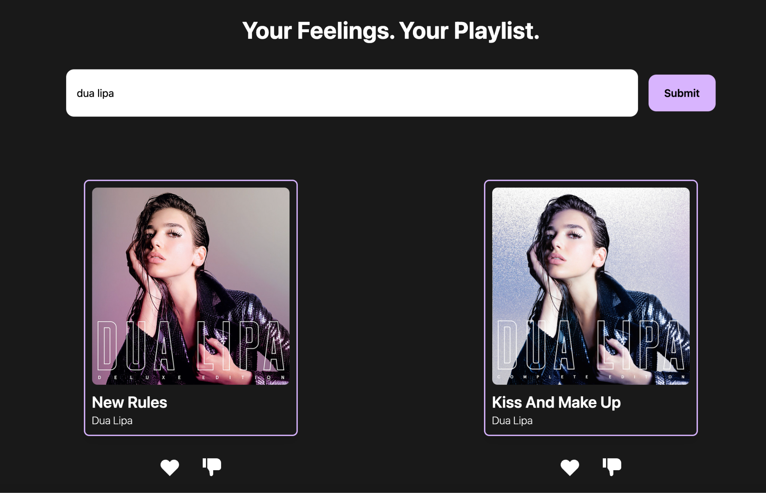
Linking Frontend to Search Query Backend
- The search bar finally works!
- Each search queries the API endpoint and returns song data
- Songs are put into a queue and displayed via Song Cards

Slide 3
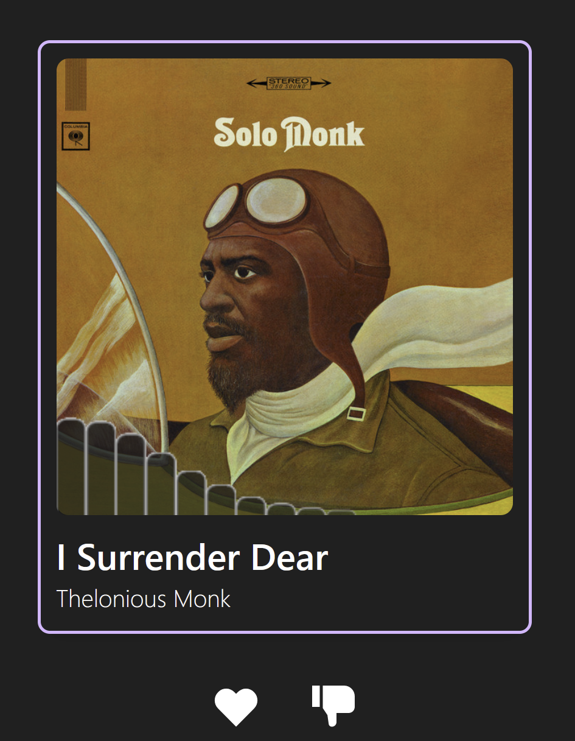

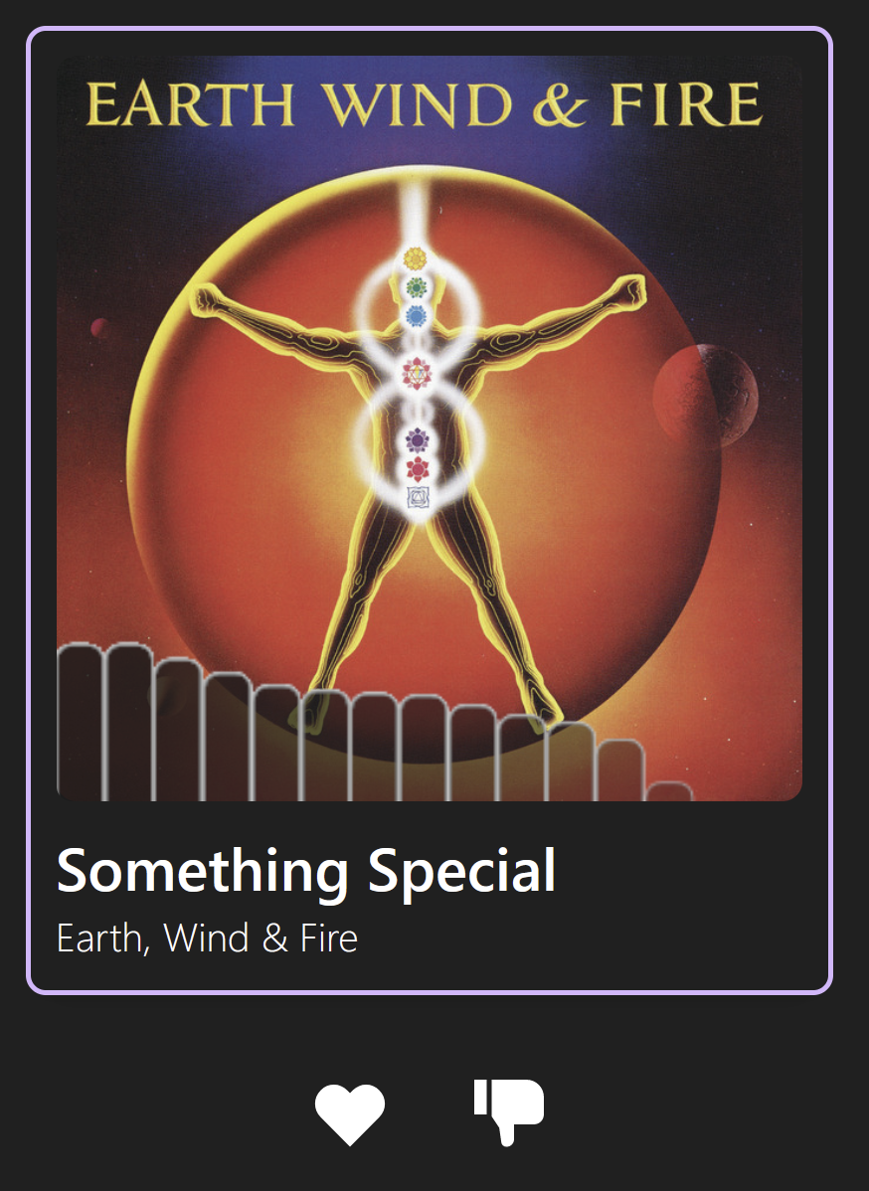
Audio Visualizer
Added the ability to visually tell which song is being played through the use of an audio visualizer
Unique for every song that shows up as long as it has a preview.
Automatically enables and disables with the associated audio.

Slide 4
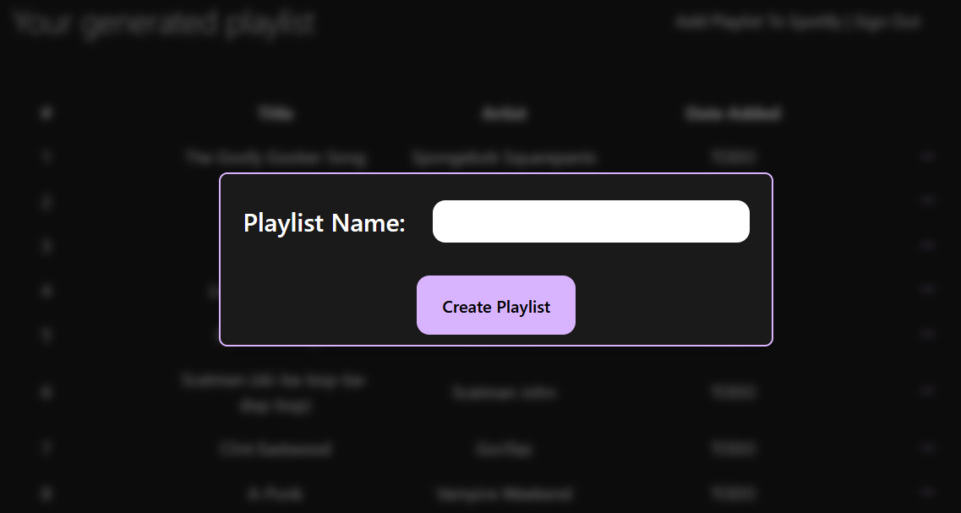
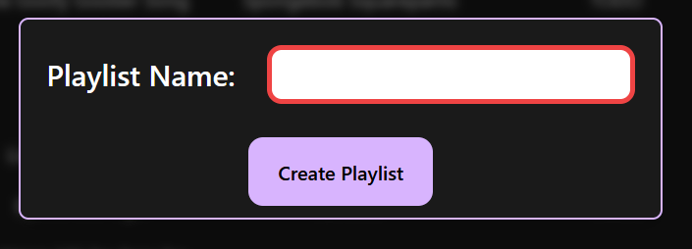
Song Selection and Playlist Generation
Can modify playlist and enter playlist name
Song selections are cached, saved between sessions/refreshes
Secure user access token storage with NextAuth sessions

Slide 5
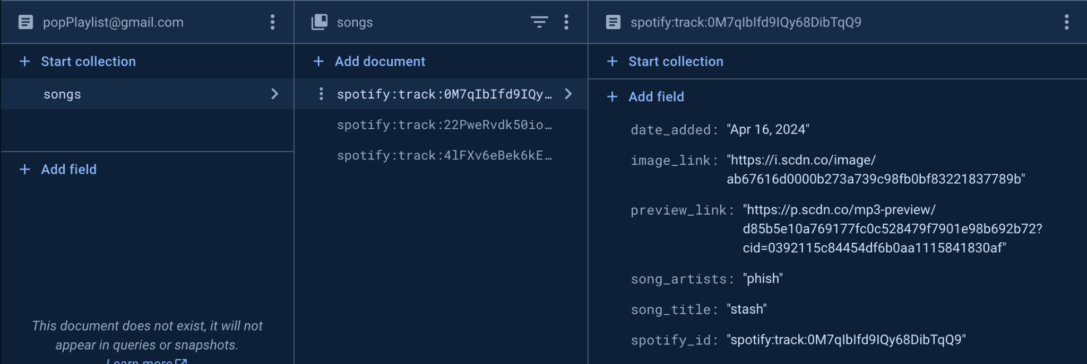
Structure of Firestore DB

Slide 6
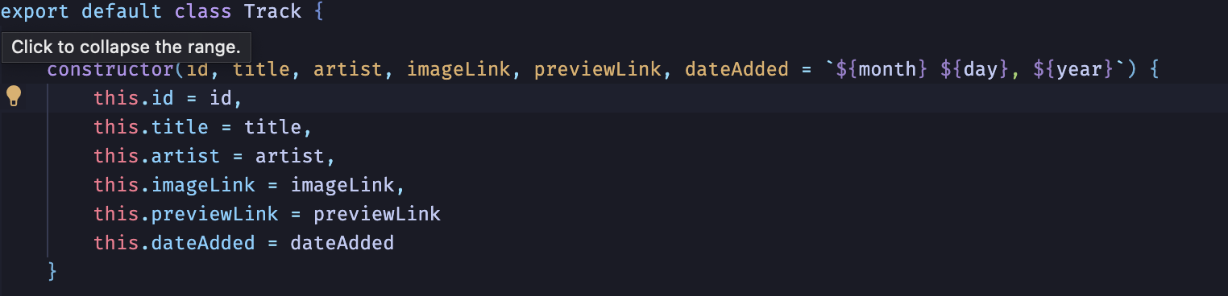
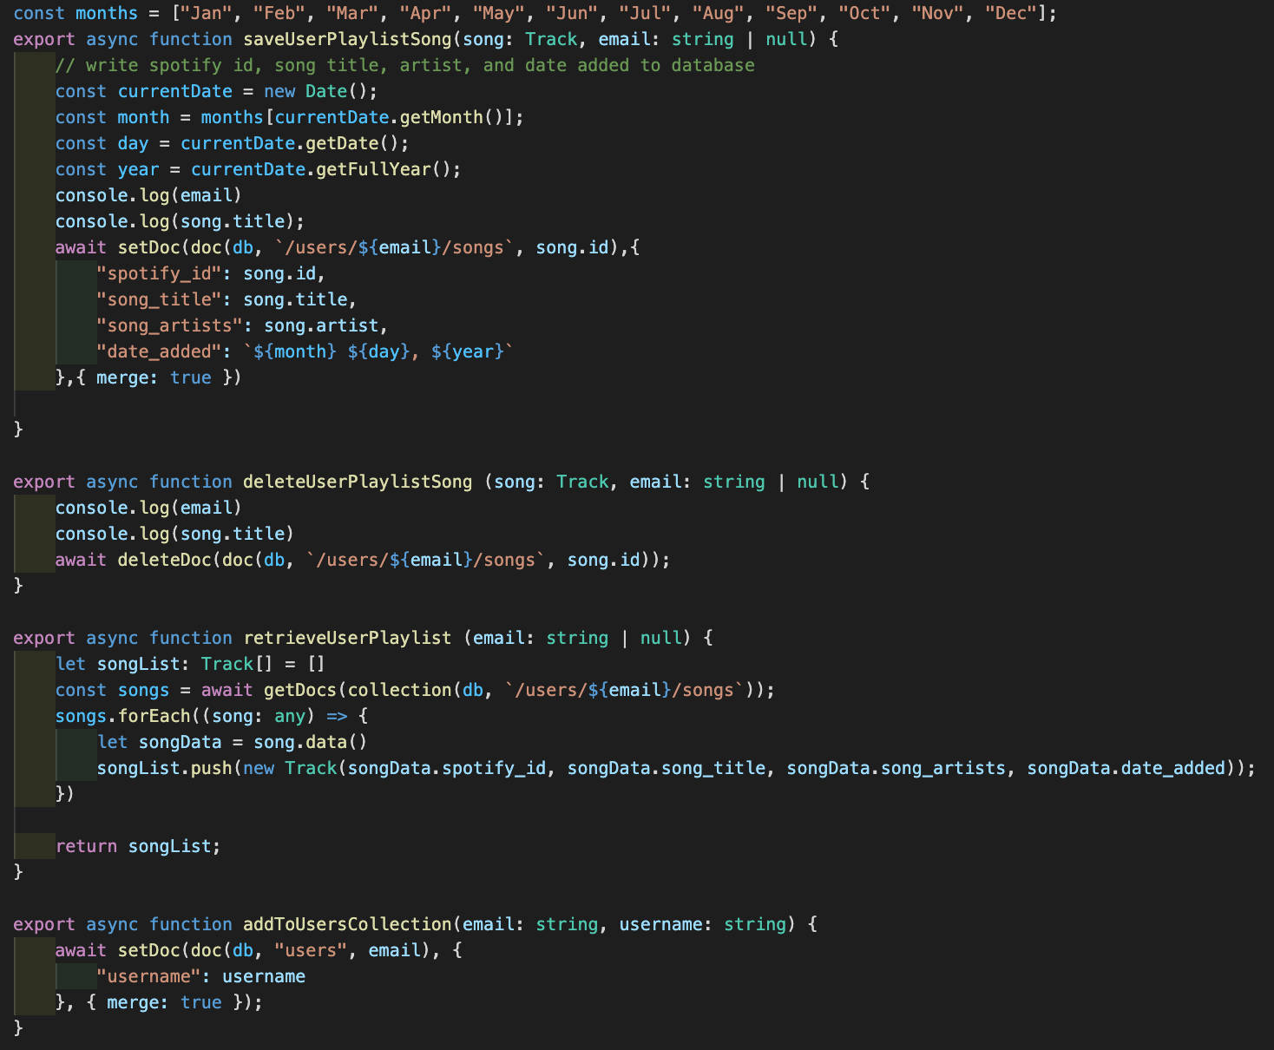
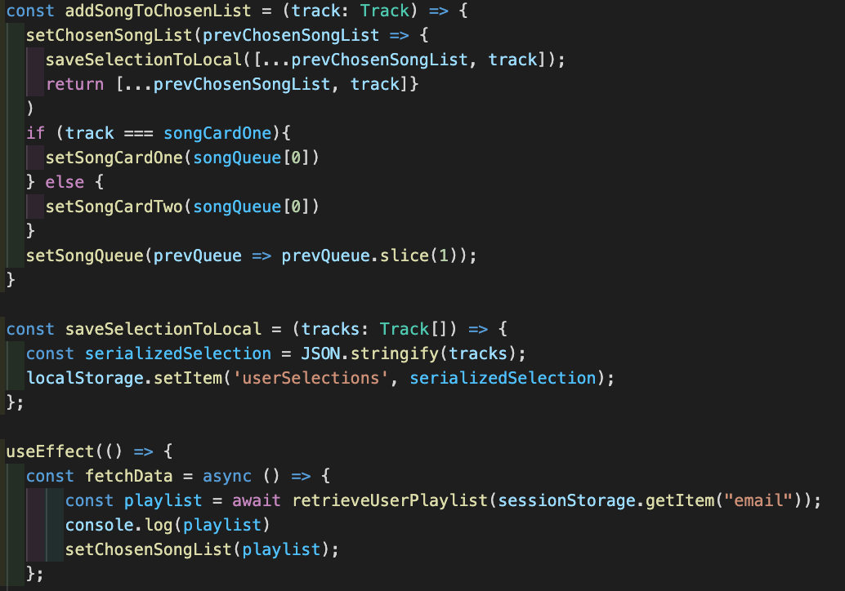
CRUD with Firestore DB

Slide 7
Firestore Demo

Slide 8
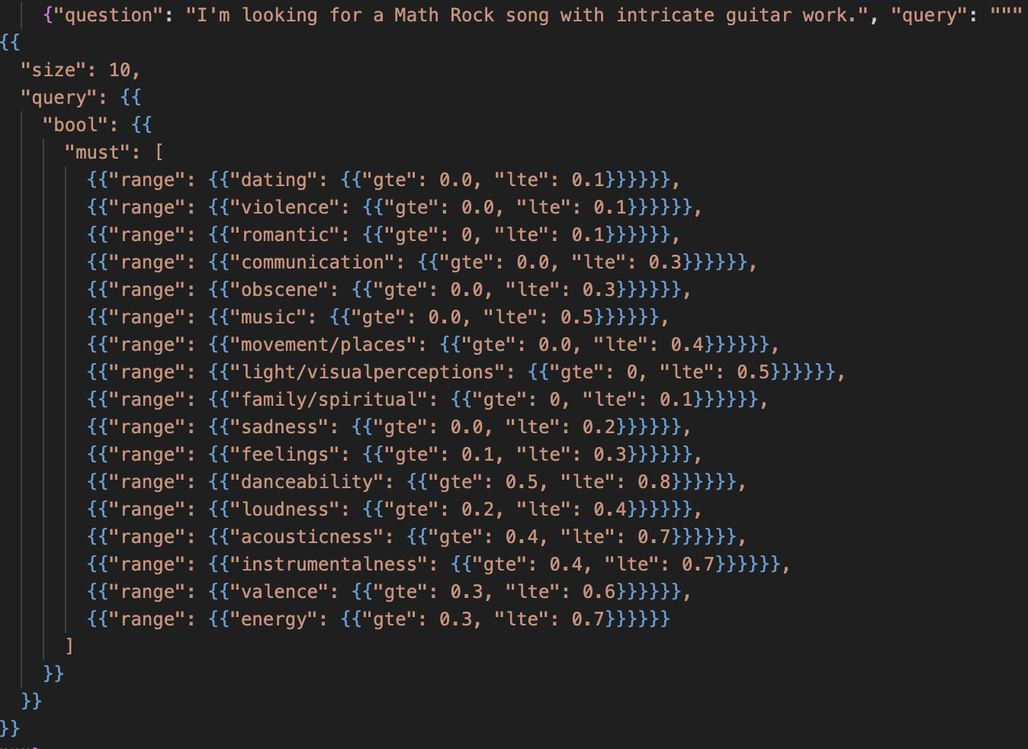
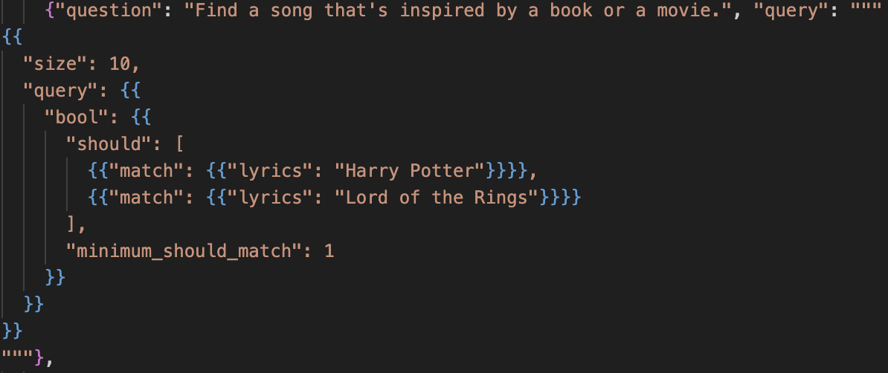
LLM ESQuery Tuning
Built a variety of ES queries to “train” the Gemini LLM
RANGE - Allow Gemini to search for different numerical attributes
Danceability, acousticness, energy
MATCH - Allow Gemini to recognize nouns in input
match lyrics or artists mentioned
Varying size and theme of queries
Some queries utilize 3-4 filters, others use 10-15
Used different “themes” of inputs to add variability to ranges
Important not to use too many filters for each query
Led to over-tuning our model which resulted in too specific of queries when developing
Notes:
More appropriate to call this prompt engineering

Slide 9



Final Backend Architecture (orchestrated with Flask)

